Slide 1
25TH ANNUAL CONFERENCE OF THE MACEDONIAN STOCK EXCHANGE
AI and Financial Markets.
How AI changes our markets, and where the advantage really sits
Filip Petrovski
CEO, Data Masters
Ohrid, 23 September 2026

Slide 2
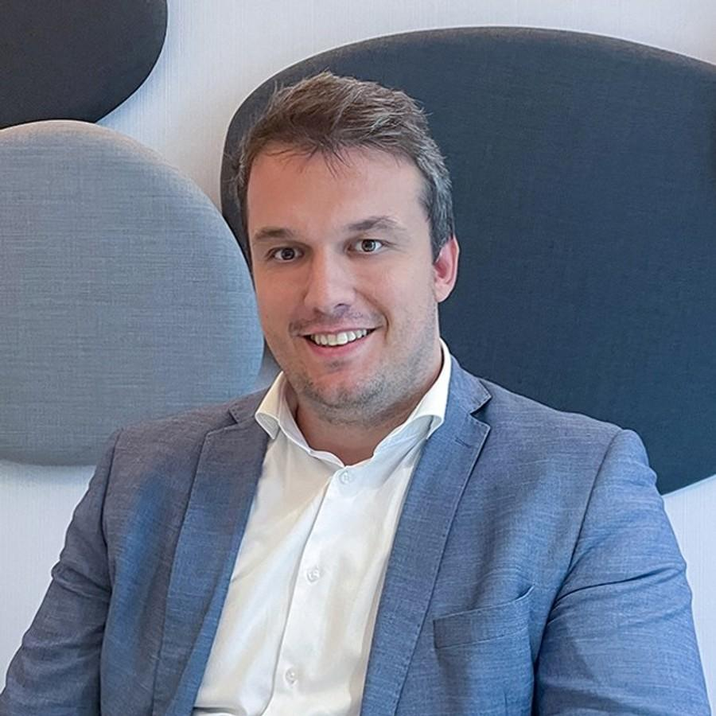
THE SPEAKER
Filip Petrovski
CEO, Data Masters
Practitioner's view: what follows comes from building these systems for a decade, and from watching where they fail.
60+
7+
600+
fixed-price data projects for banks, insurers and retailers
countries, across South-East Europe and beyond
professionals trained in data engineering and analytics
AI and Financial Markets · 25th Annual Conference of the Macedonian Stock Exchange · Ohrid, 23 September 2026
2

Slide 3
THIS TALK
Three questions for the next twenty minutes
1
2
3
How does AI change capital markets?
Will it help us make better decisions?
How do we integrate it into our work?
The models are on sale to everyone in this room. The discipline around them is what separates a result from a demo.
AI and Financial Markets · 25th Annual Conference of the Macedonian Stock Exchange · Ohrid, 23 September 2026

Slide 4
THE BUILDOUT
The world is building the intelligence
$5.2T
$965B
$700B+
Nvidia, the most valuable company on earth; under $400 billion in 2022
Anthropic in May 2026; the leading AI labs near a trillion dollars, still private
poured into AI data centres and chips by the big platforms in 2026 alone
None of it is being built here.
Nvidia alone is worth roughly seven hundred of our entire stock markets. We will not out-build this, and we do not need to. What we can build is what makes the intelligence useful inside our own companies, and that is the question worth the next twenty minutes.
AI and Financial Markets · 25th Annual Conference of the Macedonian Stock Exchange · Ohrid, 23 September 2026

Slide 5



THE SCARCE SKILL
The answer that arrived in three seconds
A question
Typed into an assistant
Read aloud as fact
nobody in the room can answer
answer back in three seconds
nobody asks the source
An unsure person hesitates and double-checks. An unsure machine answers anyway, in the same calm voice. Confidence is not proof.
Access to AI stopped being an advantage the day everyone could buy it. The advantage now is knowing when the machine is wrong.
AI and Financial Markets · 25th Annual Conference of the Macedonian Stock Exchange · Ohrid, 23 September 2026

Slide 6



THE REAL DIFFERENCE
Everyone cooks with the same ingredients
We are all pushing our teams to adopt AI. Before we go further, one question.
The chef decides
Until you prep them
The skill moved
Ten chefs, one delivery, ten different dishes. With identical ingredients, the skill in the kitchen is the whole difference.
The same model, carrying your context, your rules and the decisions you already made. A good chef now plates like your best one.
Someone decided what to prep and how. Your best people do that once, and every service after it runs on their judgement.
Your best person stops being your bottleneck.
AI and Financial Markets · 25th Annual Conference of the Macedonian Stock Exchange · Ohrid, 23 September 2026

Slide 7





ANATOMY
What a financial decision is made of
Definition
Signal
Threshold
Owner
Action
Measured outcome
"How many active customers?"
"Did it work?"
Strong in the middle, weak at both ends.
AI and Financial Markets · 25th Annual Conference of the Macedonian Stock Exchange · Ohrid, 23 September 2026

Slide 8
TODAY
How does this work today?
The old way
0% why we decided and what was the outcome?
Why does it survive?
10%
understanding it
The only gut feeling sits at the top.
Management senses a wrong number, because they carry the KPIs in their heads.
AI has no gut feeling, and an ungoverned base gives it nothing to sense with.
90% getting to the number
AI on top of this produces faster, more confident versions of the same errors.
AI and Financial Markets · 25th Annual Conference of the Macedonian Stock Exchange · Ohrid, 23 September 2026

Slide 9
THE FOUNDATION
AI is only as good as the data beneath it
21%
95%
add the foundation
correct when AI reads ungoverned data
correct on a governed foundation
wrong four times in five
near 99% in places
This was Anthropic, on its own data. The model did not change.
The data did not change. The foundation beneath them did.
AI and Financial Markets · 25th Annual Conference of the Macedonian Stock Exchange · Ohrid, 23 September 2026

Slide 10
TWO BANKS
Who returns more of the missed opportunities?
The bank that acts
day 2
the card goes quiet
day 5
the action goes out
85 days of missed opportunities
The bank that waits
day 90
the quarterly report
If noticed at all
Same data, core and market.
AI and Financial Markets · 25th Annual Conference of the Macedonian Stock Exchange · Ohrid, 23 September 2026

Slide 11
THE HONEST TEST
Measure against the decision you did not make
See
The honest question
The only question that matters in the boardroom: did the customers we acted on behave differently from the ones we left alone?
a trusted number
Measure
Act
Lift measured this way is the only AI result a regulator, an auditor and a finance director will all accept. Everything else is a demo.
the difference against those left alone
an approved action on a real customer
AI and Financial Markets · 25th Annual Conference of the Macedonian Stock Exchange · Ohrid, 23 September 2026

Slide 12
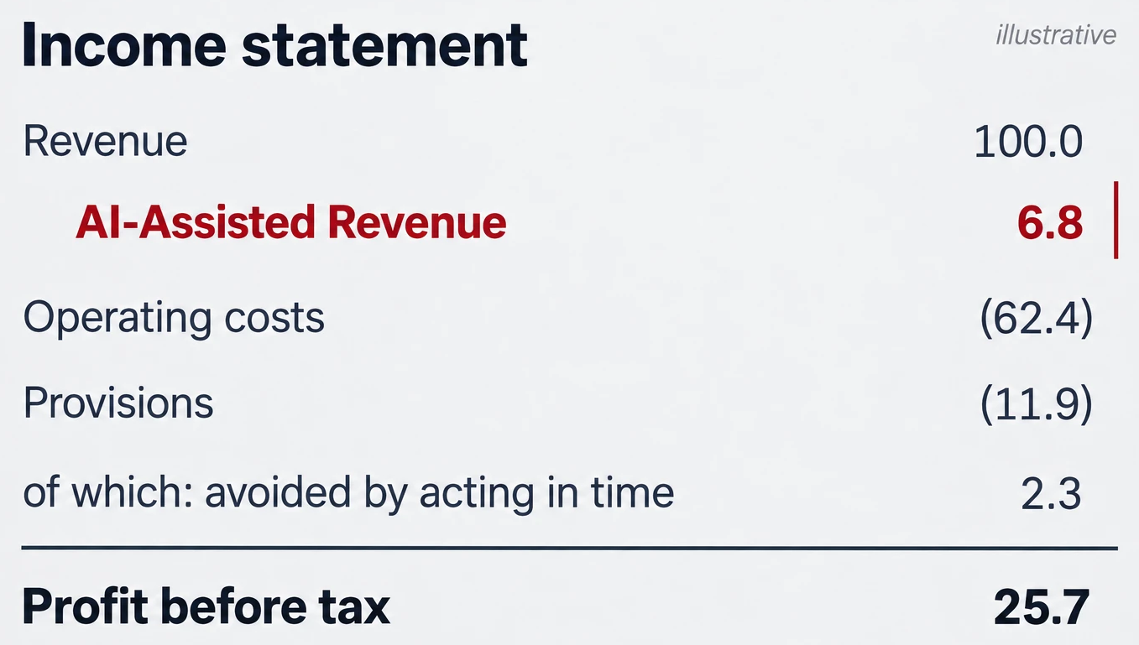
THE GOAL
AI in the top line
The red line is a sum of measured differences: acted versus left alone, decision by decision.
Measured uplift is how AI earns its line in the income statement.
AI and Financial Markets · 25th Annual Conference of the Macedonian Stock Exchange · Ohrid, 23 September 2026

Slide 13


DESIGN RULES
A person in the loop, by design
Source and definition with every answer
A trial run before it acts alone
Measure its accuracy on purpose
Approval by consequence
AI and Financial Markets · 25th Annual Conference of the Macedonian Stock Exchange · Ohrid, 23 September 2026

Slide 14
So, do we still need the people, and where?
The question every board asks next.

Slide 15


THE PEOPLE
The analyst does not disappear
AI absorbs the routine. Judgment becomes the scarce skill.
IBM tripled entry-level hiring in 2026
It redesigned the junior job instead of deleting it, and moved juniors toward customers and problems.
The analyst supplies the context which AI is lacking.
The 2008 mistake
Pulling the standard numbers moves to the machine. Choosing the right definition, checking the number before the board sees it, connecting it to a decision: that moves up to the analyst.
Freeze the juniors to save a visible salary line, then find no experienced people a few years later. That cost never sends an invoice.
AI hands the routine to the machine and hands the analyst the work that was always the point: judgment.
AI and Financial Markets · 25th Annual Conference of the Macedonian Stock Exchange · Ohrid, 23 September 2026

Slide 16
Can a market our size even play this game?
After all those trillions, a fair question.

Slide 17
THE REGIONAL ANGLE
Small and late, with the advantage in our own hands
~1 in 10
“You cannot out-model Anthropic from Skopje.
Western Balkan firms have the cloud and integrated systems that make AI trustworthy, though about half already use AI, mostly generative tools (OECD, 2026)
You can out-govern almost anyone.”
The one lever in our own hands is the foundation: the agreed meaning of every number. A weaker model on governed data beats the strongest model on a mess.
90-10-0: our old way of working. 90% getting to the number, 10% understanding it, near zero recorded on why we decided.
Being late helps only if we skip other people's mistakes and keep the necessary steps. The euphoria is theirs. The evolution has to be ours.
AI and Financial Markets · 25th Annual Conference of the Macedonian Stock Exchange · Ohrid, 23 September 2026

Slide 18
THREE ANSWERS TO TAKE HOME
1
How does AI change capital markets?
It already runs within the companies, pays off inside the companies own decisions, and better-run companies make a better market.
2
Will it help us make better decisions?
Where the number underneath is trusted and the outcome is measured against the decision you did not make.
3
How do we integrate it into our work?
One decision at a time: one owner, one number, one measurement, always having a person in the loop.
The foundation first. The intelligence follows.
Еуфоријата е нивна. Еволуцијата мора да биде наша.
AI and Financial Markets · 25th Annual Conference of the Macedonian Stock Exchange · Ohrid, 23 September 2026

Slide 19



THE SECTOR'S ASK
One ask, while we are talking about alternative funding
A purchase order dilutes nobody
The next one should ring its bell here
One unicorn is a sixth of this entire market
Let's build the first Macedonian unicorn by offering it a chance.
AI and Financial Markets · 25th Annual Conference of the Macedonian Stock Exchange · Ohrid, 23 September 2026

Slide 20

Thank you.
The foundation first. The intelligence follows.

